Slide 1
Brunel University buy and sell

Slide 2
What is Brunel Buy and Sell?
This application is all about buying and selling within students at Brunel University.
There is already a market for this as there is a Facebook page which students use to advertise their goods but it is very inconvenient as many people don’t know about the page or don’t use Facebook.
There are around roughly 1300 students who use this page already.

Slide 3
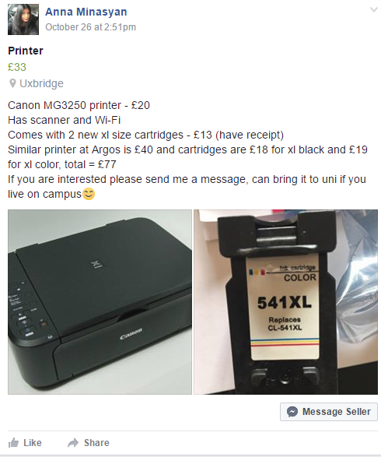
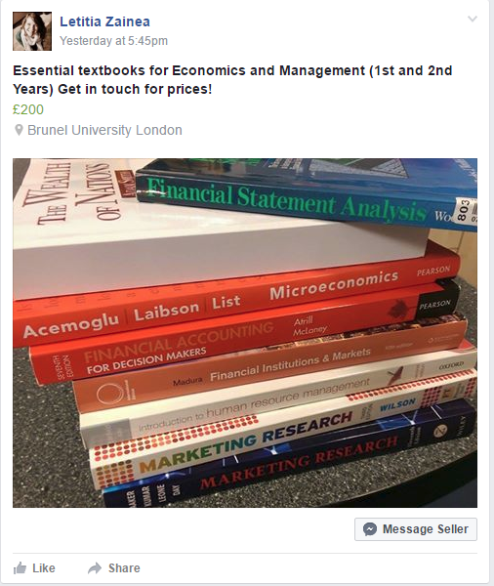
Facebook page
These are the types of
products on sale.
Students tend to buy and sell books for cheaper making it extremely helpful for new students.
Useful electronics such as printers, TV, laptops and more are put on sale.

Slide 4
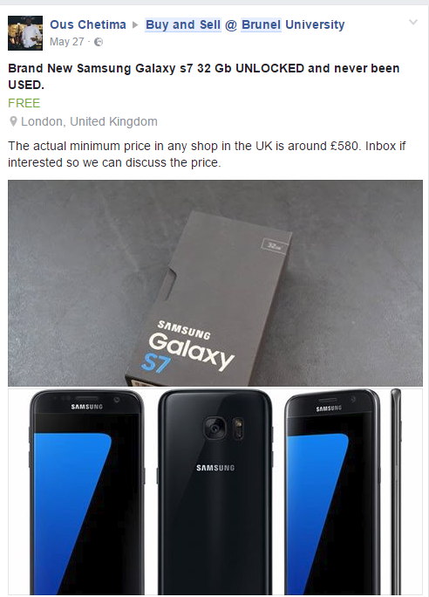
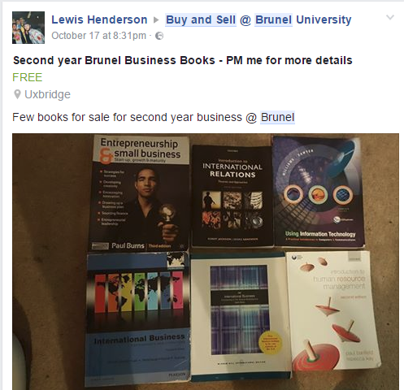
One of the issues of the Facebook page is the pricing as the sellers cant always put down the correct prices for the product they are selling.
This can make it confusing for the buyers.

Slide 5
Thank you for listening

